Slide 1


May 2024
Optimizing Strategies: An Analysis of Wanderon’s Travel Package Bookings
Prepared By: Atul Rana

Slide 2
Overview
Company Background
Wanderon was setup in 2017 by link minded people coming from premier Indian institute (NIT) with an idea to streamline travelling and vactions planning a smooth online experience for customer and convert the traditional travel planning into single source of destination for all travel itenieries and planning.
Being in this online travel industry since 2017, clientele includes paytm, TVS and many more.
Serves domestic and internal packages for customers all over the world.
Introduction
Dataset Description: The analysis is based on raw data comprising 93,000 total opportunities involving 84 salespersons.
Purpose of Analysis: The analysis was conducted to understand sales performance, identify top-performing salespersons, and optimize sales strategies to enhance overall performance
Key Metrics: SPL (Speed per lead), revenue earned per lead *.

Slide 3




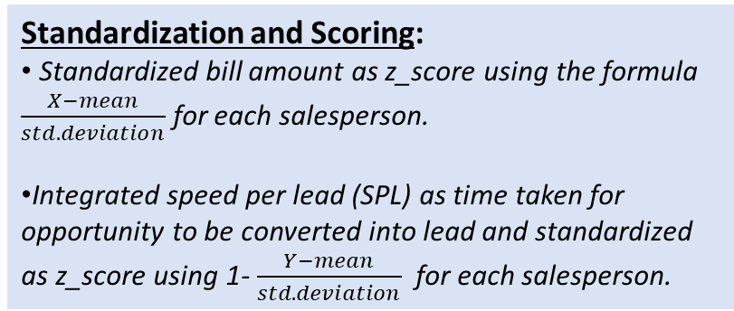
Analysis Methodology
Data Cleaning and Preparation:
Removed salespersons with zero converted leads (10% of total).
Handled instances where no opportunities were initially assigned but later converted to leads."
Ranking System:
Overall Z-Score = 90% of bill amount Z-Score + 10% of SPL Z-Score.
Ranks were assigned from lowest to highest overall Z-Score.
Standardization and Scoring:
Standardized bill amount as z_score using the formula $\frac{X−mean}{std.deviation}$ for each salesperson.
Integrated speed per lead (SPL) as time taken for opportunity to be converted into lead and standardized as z_score using 1- $\frac{Y−mean}{std.deviation}$ for each salesperson.
Categorization of salesperson*:
Elite (95%-100%): Rank >= 0.95.
Strong (84%-94%): Rank >= 0.84.
Serviceable (51%-83%): Rank >= 0.51.
Weak (0%-50%): Rank < 0.51.

Slide 4
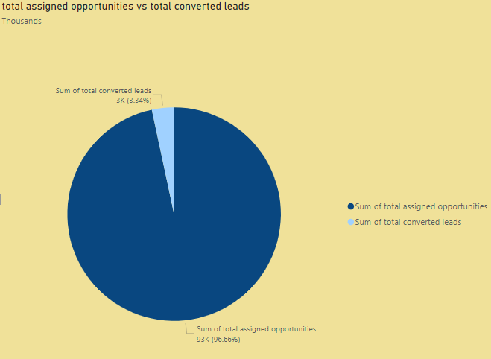
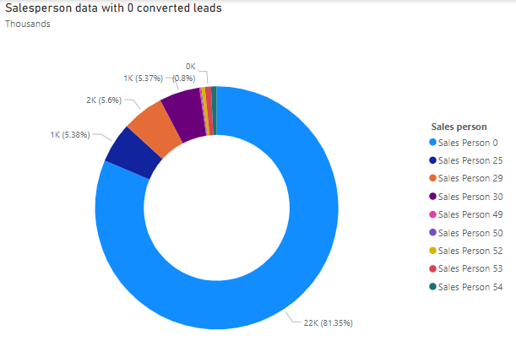
Q3’23 indicates translation of opportunities to leads by 3.34% with 81% of overall opportunities assigned to 1 sales person

Slide 5
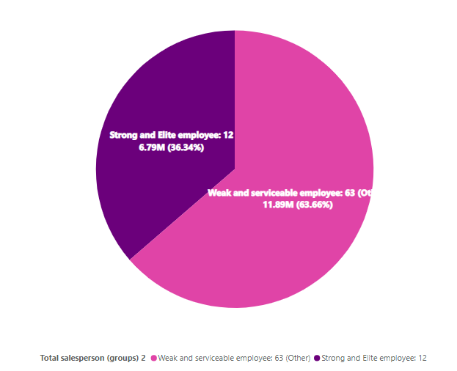
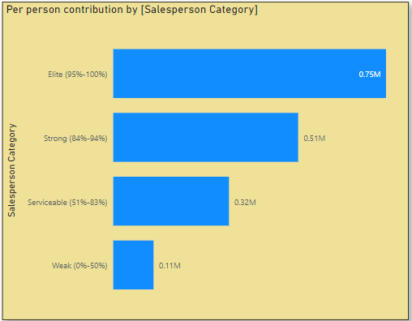
As on Q3’23, more than 1/3 of total revenue were brought by 10% of total salesperson labeled as [strong and elite salesperson]

Slide 6
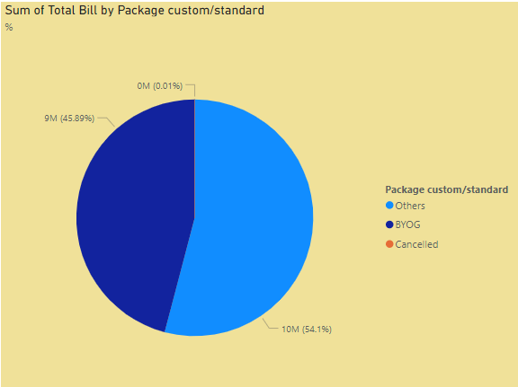
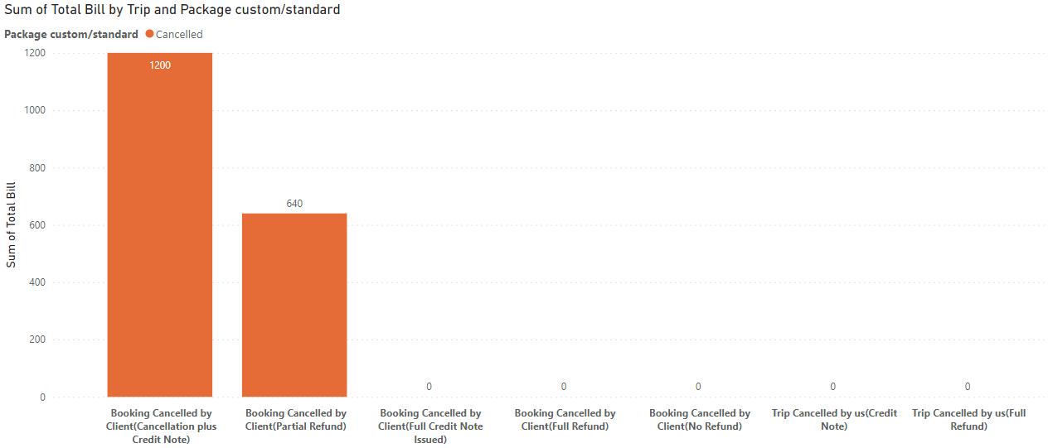
Lost leads contribute to <1% of total bill amount, signifying healthy cancellation rate

Slide 7
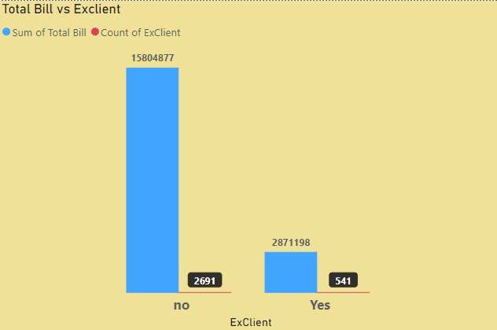
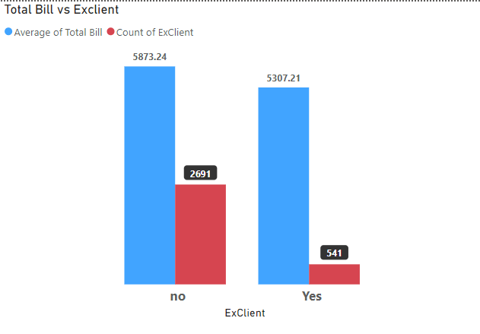
ExClient account for 20% of our customer base and contribute 18% of the overall bill amount. Analysis shows that the average bill generated by them is 0.9 times that of non-ExCliente.

Slide 8
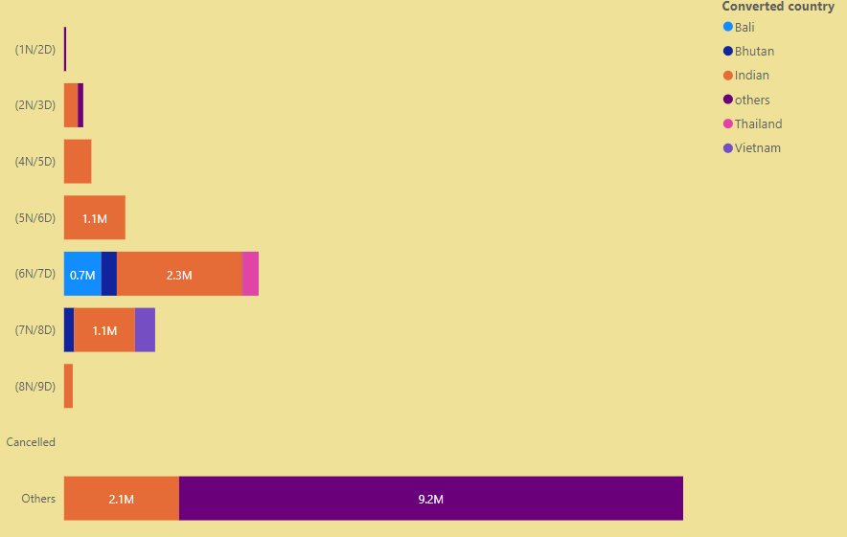
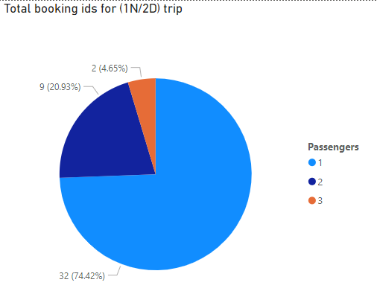
2nd popular choice of cliente is (6N/7D), with least popular choice is (1N/2D), majority of (1N/2D) package are solo travellers

Slide 9
Recommendations
Data anomalies mitigation strategies
Improve Data Allocation: Ensure all salespersons are assigned opportunities to maximize conversion potential.
Investigate Outliers: Further analysis needed for leads with no bill amount to understand and address underlying issues.
Clustering of Trip and Enquiry Destinations: Grouping trip and enquiry destinations into broader categories through clustering will help streamline analysis. Currently, there are over 50 categories, which complicates identifying trends and issues. Consolidating these into fewer, more manageable clusters will facilitate better insight and decision-making.
New methodologies ideas
Age Segregation: Further break down age categories to distinguish between youth and adult preferences. This will help in understanding the distinct behavior and choices of different age groups.
Customer Feedback: Collect and analyze customer feedback systematically to identify specific areas for improvement. Use this feedback to enhance service offerings and customer satisfaction.
Scoring : Ensuring appropriate weightage to both SPL (Speed per Lead) and total bill amount (revenue) will motivate salespersons to close leads quickly while maximizing revenue. This balanced approach incentivizes efficiency and profitability, driving better overall performance.

Slide 10
Streamline Naming Conventions: To enhance clarity and consistency, adopt a structured naming convention for trip statuses. This can be achieved by categorizing trips based on the following criteria:
Country/Region: Group trips by the primary destination (e.g., Bhutan, Kashmir, Spiti).
Duration: Indicate the length of the trip in a standard format (e.g., 1D/2D for same-day packages, 6N/7D for week-long trips).
Special Offers: Use a separate flag for promotions such as early bird offers or special discounts.
Example of a standardized format: [Destination]-[Season/Theme]-[Duration] (e.g., Kashmir-Winter Backpacking-(1N/2D), Spiti-Summer-(5N/6D))

